Slide 1
Medical Visual Question Answering
Group Members Nidhin Mohan- B180948CS Shaaheen A M- B181134CS Abhinav B Naik- B170297CS
Guided by: Dr. Saidalavi Kalady Dr. S. Sheerazuddin

Slide 2
Introduction

Slide 3
Medical Visual Question Answering(Med-VQA)
Med-VQA is a subtask of VQA, where we perform VQA on medical images. It has a wide variety of uses especially in the field of radiology and also in the diagnosis of tumours.
For our project we had trained our model using the data available in the SLAKE dataset, which had 642 images and over 14 thousand question-answer pairs.
The existing Medical VQA models present in the papers we reviewed had on average about 50-70% accuracies.

Slide 4
SLAKE Dataset

Slide 5
The SLAKE Dataset is used for training our Medical VQA model.
It contains 9,835 training examples and 2,094 testing examples. Each example is a question-answer pair.
Question-answers are divided into open-ended and closed-ended questions, with the dataset containing both English and Chinese questions.
Questions were of two base types: vqa and kvqa.

Slide 6
For our model, we only considered English questions which are of base type vqa, that is, questions which require external knowledge were not considered.
Questions were of mainly four types. We selected the questions marked green:
Closed-ended questions with yes/no
Closed-ended multiple choice questions
Open-ended multiple answers questions
Open-ended single answers questions

Slide 7
Design

Slide 8
Image Feature Extraction
There are 3 parts for our VQA framework
Feature Extraction
Feature Fusion
Classification
Model used- VGG16 pretrained on ImageNet database.
Input- 224x224x3 dimensional images. Output- 1x1000 dimensional class probability vector with the final fully connected and softmax layers. 7x7x512 feature vector without the final four layers.
Known to give good accuracies in existing Med-VQA models.

Slide 9
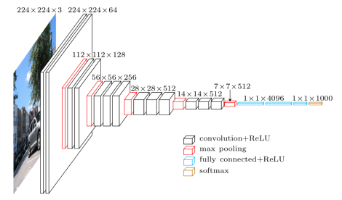
VGG16 model architecture. For our project, we have removed the final three fully connected layers and the softmax layer since we only want the image features.

Slide 10
Principal Component Analysis
Flattened image feature vector shape- 1x25088
Principal Component Analysis performed to reduce the dimension of feature vector.
Linear Algebraic method for dimensionality reduction using covariance matrix, eigenvectors and eigenvalues.
Number of principal components chosen- 512
Final image vector dimension- 1x512 for each image

Slide 11
Question Feature Extraction
Each question embedded using GloVe word embeddings and an LSTM model.
GloVe- contains 100-dimensional embedding for about 4,00,000 words.
Each question encoded using a tokenizer, padded to a maximum length of 16 and embedded using GloVe to obtain a 16x100 shape vector.
Questions are processed through the LSTM model to obtain a 1x800 dimensional feature vector.
Dimensionality reduced to 1x512 using PCA.

Slide 12
Feature Fusion and Classification
For each image-question pair, the 1x512 image vector and 1x512 question vector has been concatenated to form a 1x1024 vector.
The 1x1024 image-question fused feature vector is passed through a simple softmax classifier.
Total number of answer classes- 133
Softmax Classifier: Input- 1x1024 Image-Question vector. Output- 1x133 probability vector containing probabilities of an answer.
Answer with maximum probability chosen as the correct one.

Slide 13
Design Changes
Removed Question Conditioned Reasoning, Task Conditioned Reasoning, MAML and MMQ modules.
Used VGG16 instead of a simple CNN model for image feature extraction.
Replaced Bilinear Attention Networks with concatenation and Multilayer Perceptron Classifier with a simple fully connected model.

Slide 14
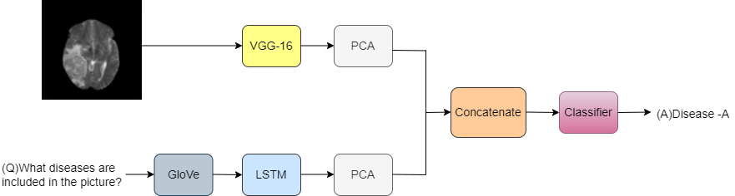
Proposed Medical VQA Framework

Slide 15
Implementation Progress

Slide 16
We have used a VGG16 model for obtaining image features and and an LSTM model for obtaining Question features.
PCA is performed on both image vectors and question vectors separately after getting their feature vectors from their respective models
The image and question vectors have been then concatenated to obtain a fused vector which is then passed onto the final classifier
The final classifier has been implemented and the fused feature vectors are passed onto it to obtain the outputs.

Slide 17
Results

Slide 18
At the moment, our model has produced less than satisfactory results on the training, testing and validation datasets
The results are shown below:
TYPE | ACCURACY | LOSS
Training | 19.49.% | 3.597
Validation | 17.76% | 3.348
Testing | 18.16% | 2.963
The low accuracies can be due to use of very simple components for feature fusion, question feature extraction and classification.

Slide 19
Conclusion and Future work

Slide 20
The low accuracies can be explained by our use of basic models for question feature extraction, feature fusion and classification.
To have better accuracy,
The feature fusion part has to be updated with Attention Networks.
Question feature extraction model can be substituted with a more effective LSTM model.
Using a Multilayer Perceptron Classifier instead of a simple 3-layer classifier.
For image feature extraction, instead of VGG16 other models which have been particularly trained on medical images can be used.

